Slide 1
Assignment 2 - Smart contracts
By. Sebastian Christiansen

Slide 2
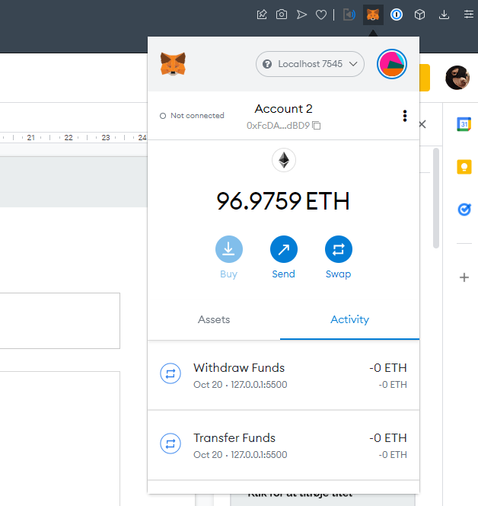
Getting a crypto wallet
I used MetaMask for this.
We simply need a crypto wallet to connect to the website (more on that later) to transact - change the state of the contract.
MetaMask needs to connect to the locally running Ethereum network...

Slide 3
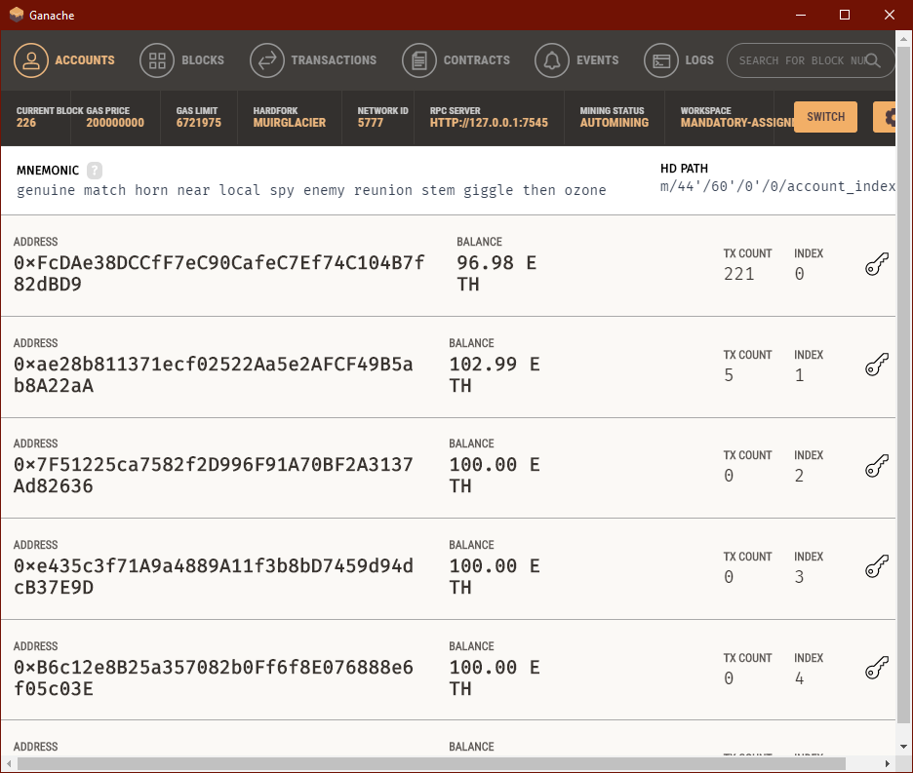
A local Ethereum network
With Ganache, one can simply create a new workspace which will spin up a new local Ethereum network with its own blockchain.
This is great for testing smart contracts as the preparation time is near null.
Ganache also creates 6 (or more) wallets for you to play with, each having 100 ETH by default.
The Ethereum network will be automatically accessible at localhost:7545.

Slide 4
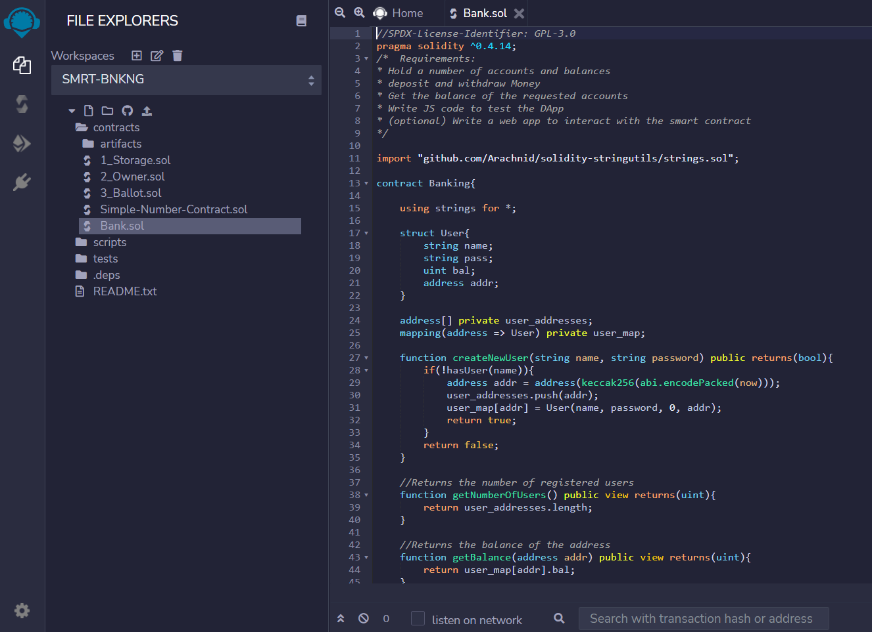
Writing a smart contract
I used Remix (remix.ethereum.org) to write the contract, this includes a compiler (to get an ABI) and a deploy and debug tool.
The language is Solidity

Slide 5
Contract code
Contracts can be thought of as classes, with dependencies, variables, and functions.
Address are simply values in hex.
Mapping these are hashmaps of key => value pairs
Struct objects with specified variables
Function visibility can be public and internal (private)
Contract Banking{
struct User{
string name;
string pass;
uint bal;
address addr;
}
address[] private user_addresses;
mapping(address => User) private user_map;
function createNewUser(string name, string password) public returns(bool){
if(!hasUser(name)){
address addr = address(keccak256(abi.encodePacked(now)));
user_addresses.push(addr);
user_map[addr] = User(name, password, 0, addr);
return true;
}
return false;
}

Slide 6
Function return
View: specifies read-only functions
Payable (default, none): specify a change in state, must be compensated with a gas price.
function getBalance(address addr) public view returns(uint){
return user_map[addr].bal;
}

Slide 7
Function multiple return
function withdrawFunds(address addr, uint funds) public returns(bool, string){
…
return (true, "Withdrew funds");
...
}

Slide 8
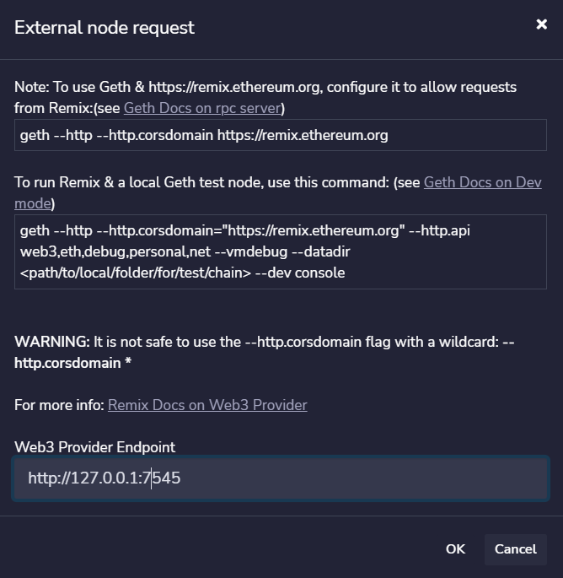
Connecting Remix to the Ethereum network
One simply goes to ‘deploy and run’ and connects it to the ‘Web3 provider environment’.

Slide 9
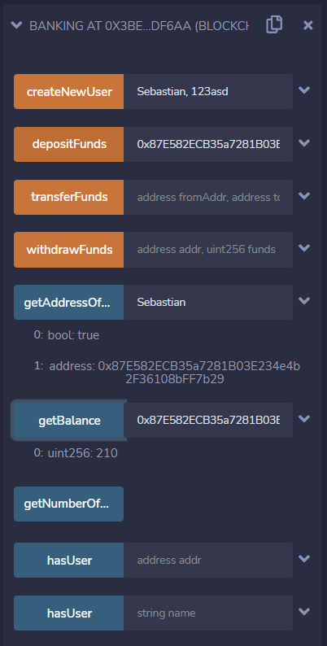
Once deployed
Once the smart contract is deployed, we can test in on-site easily.
We can easily call functions of the contract and check the returned values (easier than website calls).

Slide 10
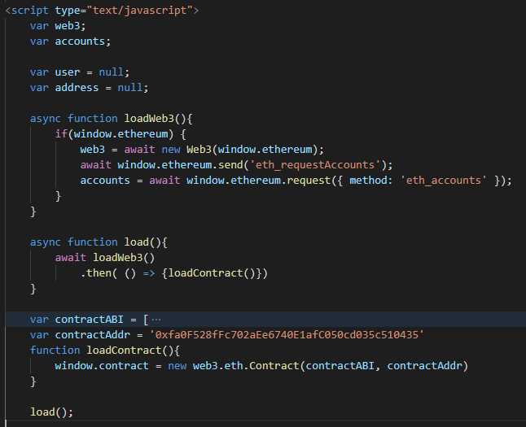
Writing a web application
We can instantiate a Web3 object, then send a request to connect accounts from a wallet (MetaMask).
Once the Web3 is instantiated and accounts loaded we can store the contract using its ABI and Address on the blockchain.
The ABI (Application Binary Interface) is used to describe the functions of the Contract.
The webpage requires a JS runtime - I use the ‘live server’ extension to VS code for this.

Slide 11
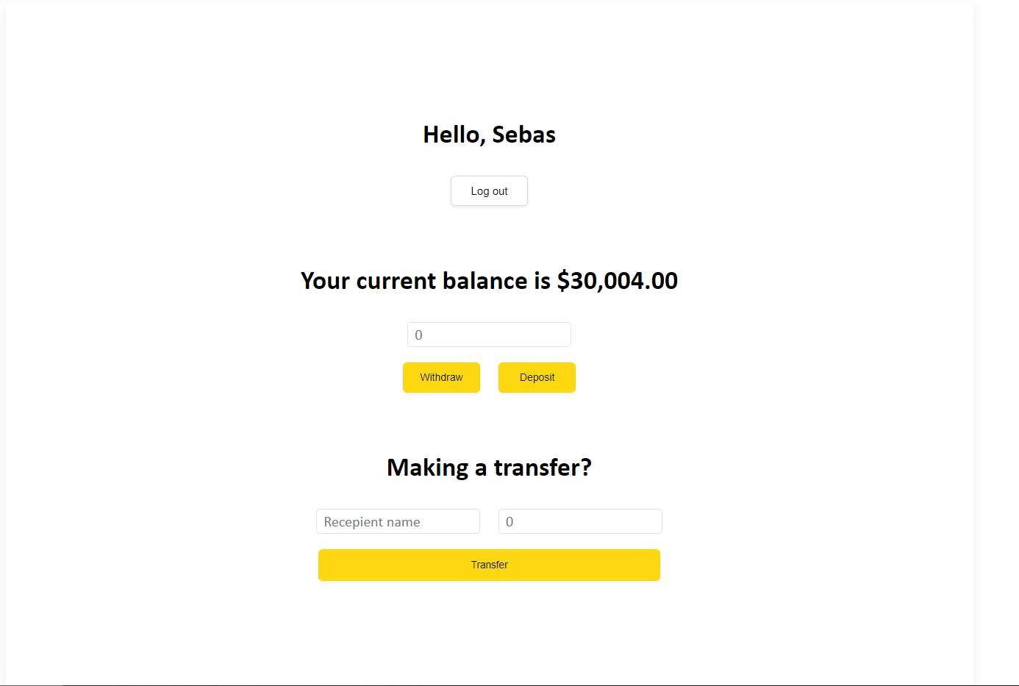
Webpage

Slide 12
Webpage calls to smart contract
We can simply access (and await) the contract methods as stored earlier.
The call() specifies a read-only operation on the state of the contract. This is free, as it does not change the state.

Slide 13
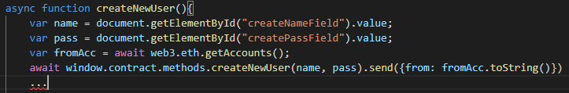
Webpage transaction to smart contract
Again I access the stored contracts method, and pass the proper parameters.
The send() specifies a transaction, these const gas, thus I must specify which account to pay with. The payment is only a gas price, used to compensate miners for processing the transaction.

Slide 14
That’s it..
The rest is just HTML, which is unimportant for this project.

